Slide 1
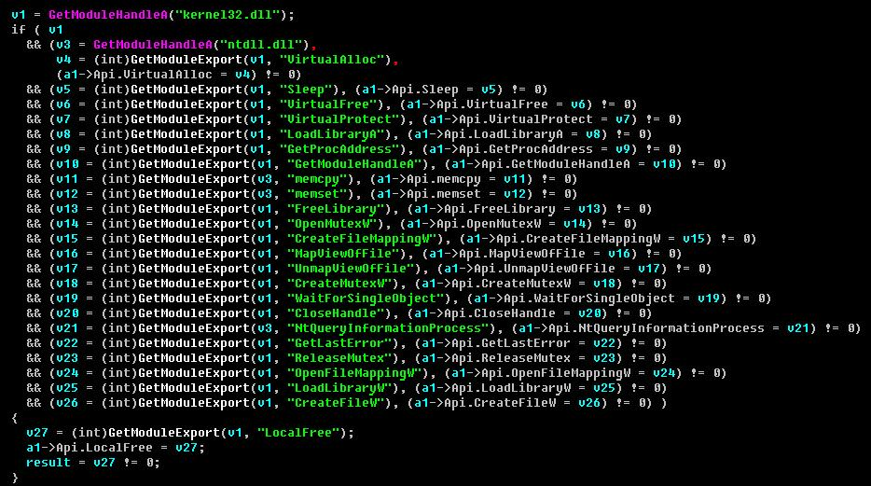
Stuxnet: The Government Funded Computer Worm
By: Jacob Braddock
Charleston Southern University
Figure 1. Lines of Code from the Stuxnet Virus (Animalia Life, n.d.)

Slide 2
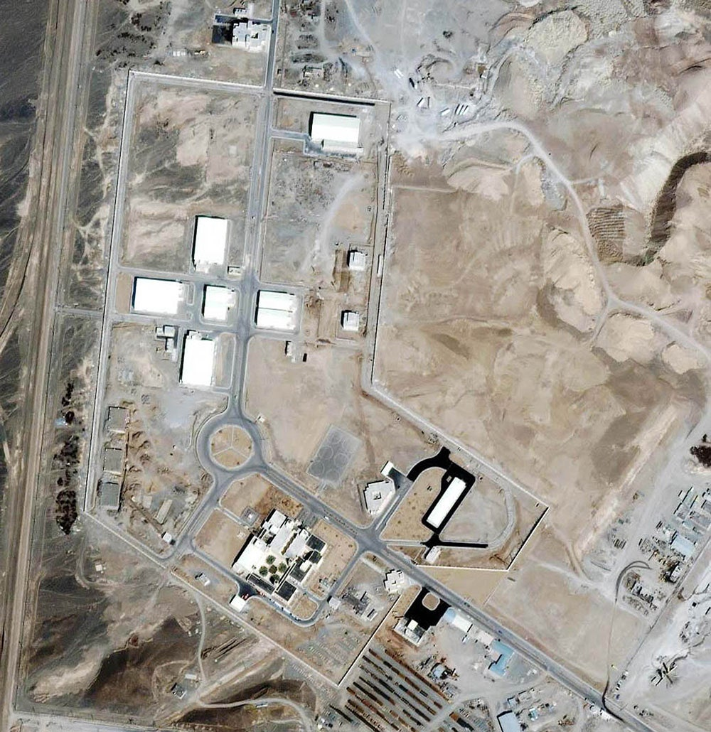
Stuxnet: The Origin
Stuxnet is a powerful computer worm designed by U.S. and Israeli intelligence that to disable a key part of the Iranian nuclear program (Fruhlinger, 2022)
There were major fears at the time that Iran was building nuclear devices, with Israel ready to strike in retaliation. The Bush and Obama Administration wanted to prevent a major war from breaking out.
Was one of the first cyber weapons ever created
Figure 2. Natanz Nuclear Complex in Iran (Zetter, 2014)

Slide 3
Cyber Weapons?
Rather Hard to describe what they are as they have many similarities to cyber crimes
According to the Tallin Manual on the International Law Applicable to Cyber Warfare, cyber weapons are cyber means of warfare designed, used or intended to cause either injury or death of people or damage to or destruction of objects (Brecht, 2015)
Stuxnet was the first one created to specifically cripple the nuclear sector of an entire country, the first cyber weapon ever created, and showed cyber attacks could have real world impact (destruction of property, harm, etc)

Slide 4
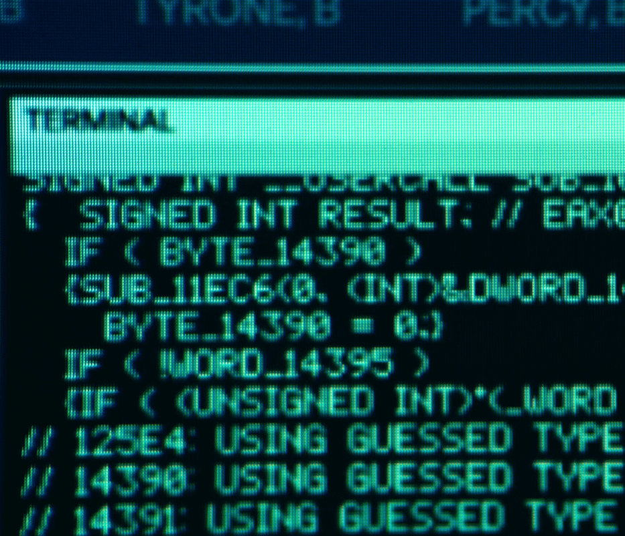
The Discovery
Originally targeted at the Natanz Nuclear facility, the virus spread too fast and far
Went outside of its geopolitical location
Stuxnet soon became known to the security community thanks to a call to tech support. An office in Iran (not part of the nuclear program) was experiencing mysterious reboots and blue screens of death, which were even affecting computers with fresh OS installs (Fruhlinger, 2022)
Figure 3. Stuxnet as seen on a Computer Terminal (mcsaeid, 2022)

Slide 5
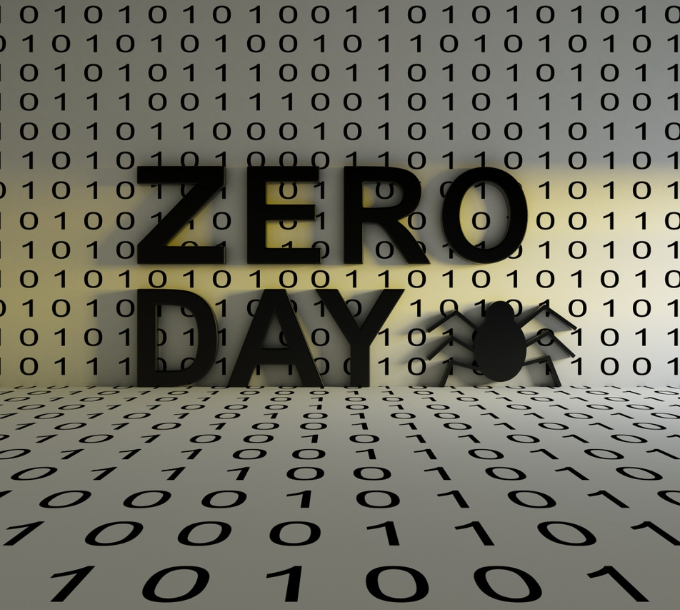
How Does it Work?
Multiple languages, including C and C++
Exploited 4 Zero Day Exploits (Zero Day Exploits are exploits unknown to the devs, specialists to mitigate it) which is unheard of
Delivered by USB, the Worm then would self-propagate to other computers on the system
Abuse rootkits to go undetected and used stolen credentials for logins

Slide 6
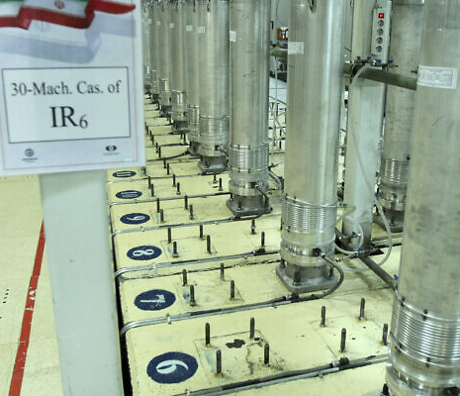
Impact
Stuxnet was designed to destroy the centrifuges Iran was using to enrich uranium as part of its nuclear program (Fruhlinger, 2022)
These centrifuges become delicate as they enrich uranium and spin
Stuxnet attacks both Windows and PLC (programmable logic controller) which are used to control physical objects (such as the centrifuges)
The virus would then change the PLC to spin the centrifuges irregularly, destroying them
Would then move onto the next computer
Figure 5. Natanz Centrifuge Machines (Staff, 2021)

Slide 7
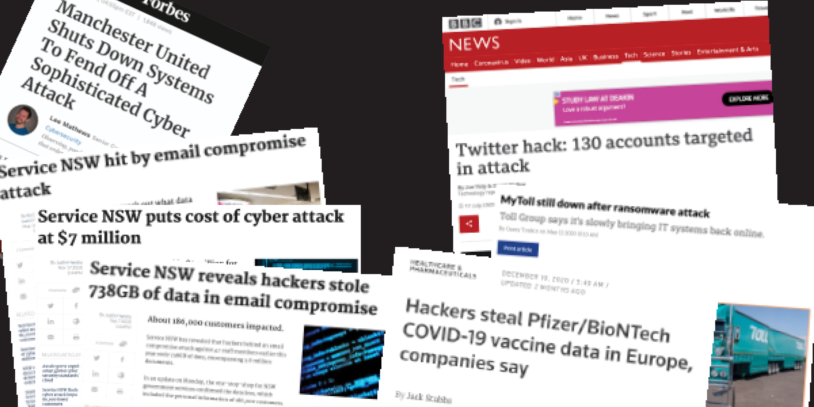
Cybersecurity Implications
Stuxnet demonstrated that nation-states could deploy cyber weapons to achieve strategic objectives (Katikar 2024)
The precedent was set for future state weapons to be used in state funded attacks
Figure 6. Various Cyber Attacks in Recent Years (MailGuard, 2024)

Slide 8
Cybersecurity Implications cont.
Black Hat Hackers are reverse engineering parts of Stuxnet to use maliciously
Reaserchers as well are building off the worm as well
Modernized, weaponized, and popularized the usage of these these types of weapons, especially in modern times (Hamas-Israeli Conflict, Russia-Ukraine War)

Slide 9
Future of Cyberweapons
Multiple state funded cyber attacks have occurred in recents years
Viruses such as Flame, a spyware targeted towards Iran as well
NotPetya, a Russian Sponsored virus designed to destroy western computers
Triton, also a Russian Sponsored state hack to cripple western safety systems

Slide 10
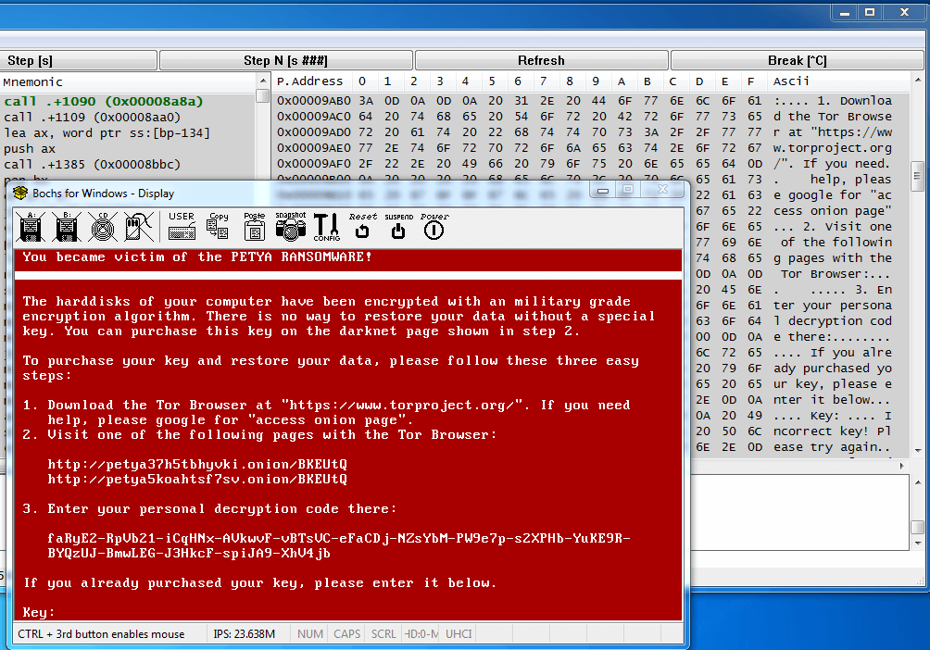
Figure 7. NotPetya in Action (Alvarez, 2017)

Slide 11
Current State of Iran Nuclear Program
No Nuclear weapons are in Iran or have been produced recently
Due to ongoing Israeli conflict, most weapon development sites have been crippled
In October 2024, Israel conducted its largest-ever direct attack on Iran, targeting its air defenses and missile production facilities (Masters & Merrow, 2024)

Slide 12
References
Alvarez, R. (2017, July 9). Key differences between Petya and Notpetya. Fortinet Blog. https://www.fortinet.com/blog/threat-research/key-differences-between-petya-and-notpetya
Brecht, D. (2015, January 15). Cyber Warfare and cyber weapons, a real and growing threat | infosec. Infosec. https://www.infosecinstitute.com/resources/general-security/cyber-warfare-cyber-weapons-real-growing-threat/
Fruhlinger, J. (2022, August 31). Stuxnet explained: The first known cyberweapon. CSO Online. https://www.csoonline.com/article/562691/stuxnet-explained-the-first-known-cyberweapon.html
Katikar, H. (2024, August). (PDF) stuxnet-analysis and implications of the world’s first cyber-weapon. ResearchGate. https://www.researchgate.net/publication/383157048_Stuxnet-Analysis_and_Implications_of_the_World’s_First_Cyber-Weapon
MailGuard. (2021, February 25). EBook: 10 cyber-attacks that made headlines in 2020. https://www.mailguard.com.au/partner-blog/ebook-10-cyber-attacks-that-made-headlines-in-2020
Masters, J., & Merrow, W. (2024, November 24). What are Iran’s nuclear and missile capabilities? Council on Foreign Relations. https://www.cfr.org/article/what-are-irans-nuclear-and-missile-capabilities
mcsaeid. (2022). R/welcometolumon on reddit: Stuxnet code shown on a terminal. Reddit. https://www.reddit.com/r/WelcomeToLumon/comments/w7vz0f/stuxnet_code_shown_on_a_terminal/
Staff, T. (2021, April 1). Iran said enriching uranium with 4th batch of advanced centrifuges | The Times of Israel. The Times of Israel. https://www.timesofisrael.com/iran-said-enriching-uranium-with-4th-batch-of-advanced-centrifuges/
Stuxnet Codę. (n.d.). https://animalia-life.club/qa/pictures/stuxnet-code
Zetter, K. (2014, November 3). An unprecedented look at stuxnet, the world’s first Digital Weapon. Wired. https://www.wired.com/2014/11/countdown-to-zero-day-stuxnet/

